Slide 1
3d-Printed Granular Jamming Hand
Melissa Indoe
Chris Kang
Sean Phelan
Maggie Serra
Chris Wallace

Slide 2
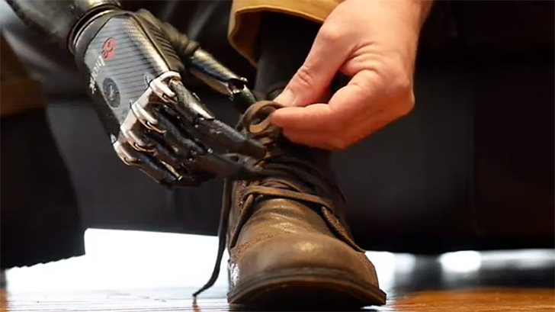
Problem Statement
3 million population of arm amputees worldwide
59% are below the elbow
Current prosthetic hands are costly
Only half of arm amputees can afford prosthetic hands
People in developing countries cannot get access to such device
There is a need to develop an affordable, readily available prosthetic hands

Slide 3
Project Objective
Create an open-source, affordable, multifunctional, 3-D printed prosthetic hand
Costs less than $500
Able to perform a number of everyday tasks
Designed such that consumer-level assembly is easy
Open source
Anyone can download the design from the internet and modify the hand to suit their own needs
Semester Objective
Fabricate a working prototype

Slide 4
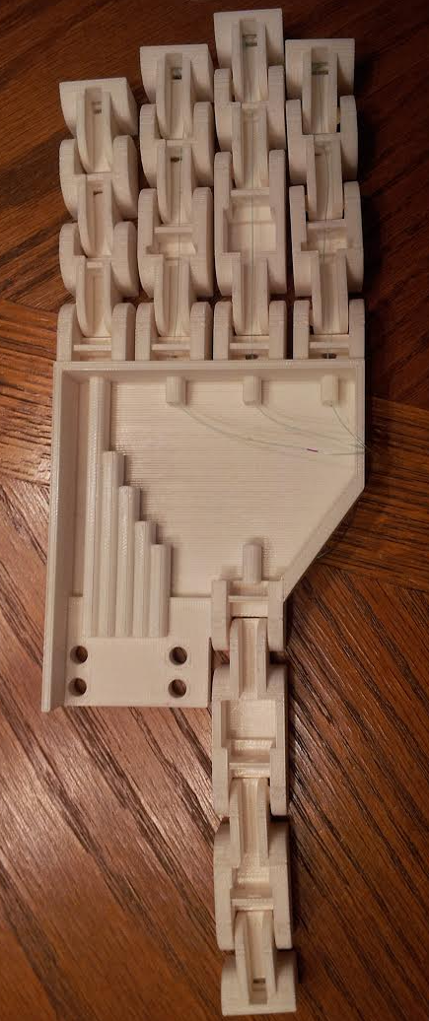
Deliverables
Phase 5:
3D printed second iteration of complete hand
Continued programming for the Arduino Uno
Updated forearm model
Revamped and tested methods for granular jamming pad production
Revamped sensor setup
Obtained additional parts
Second printed iteration of full hand.

Slide 5
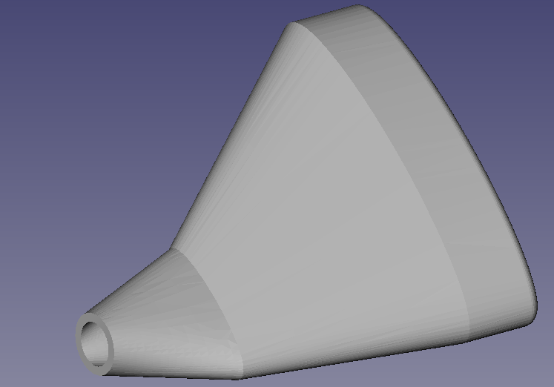
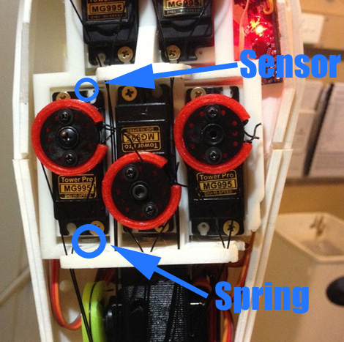
Project Review
Granular Jamming Pad design and production plan were generated in Phase 4
The production plan was to slip cast a latex pad using an ABS mold
Finger control was to be performed via sliding motors and Hall Effect sensors
Springs would enable the motors to slide
A magnet would be attached to each motor
Hall effect sensors would be attached to the housing
As the force increases, motors move, and sensors can be used to interpolate force
Granular jamming pad design.
Proposed Hall Effect sensor setup.

Slide 6
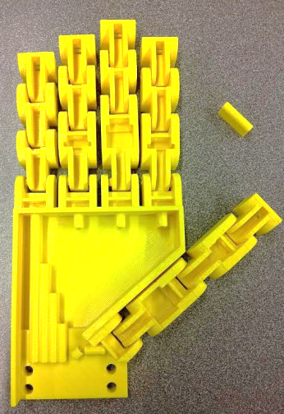
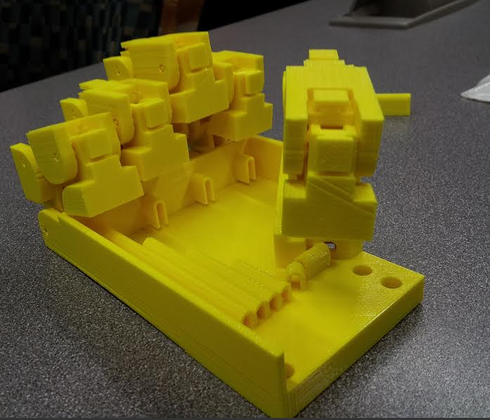



Project Review
First palm iteration was printed in Phase 4
It had several points of failure:
Finger tolerance was too small
Cable guides detached from palm surface
Thumb bent incorrectly
Design changes were proposed
Wire guides would be made shorter and with a modified cross section
Thumb would be moved to a new position
First hand iteration (top), and first palm iteration displaying thumb issues (bottom).
Old vs new cable guard design and proposed hand design

Slide 7
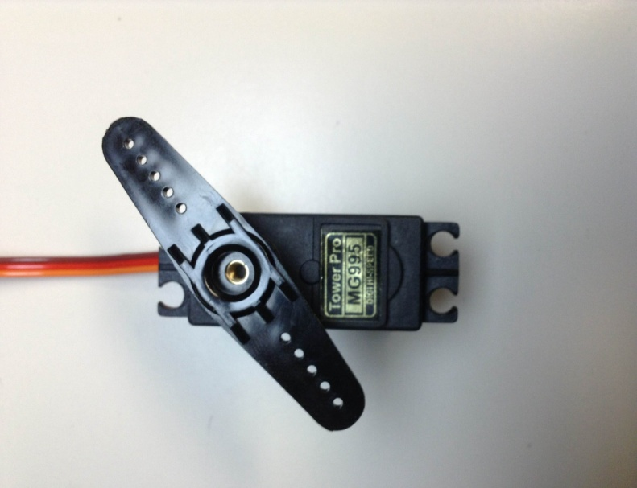
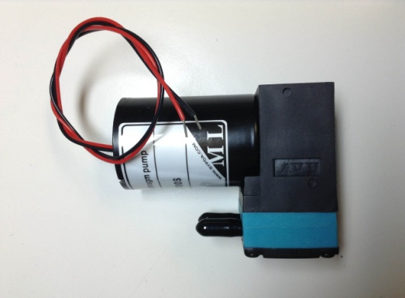
Programming Updates - Overview
Proof of concept
Not using actual connections to a human – simulate with software.
Simulate user inputs
Finger control
Control motors
Limit motor motion with potentiometer
Granular Jamming
Pump control
Valve control

Slide 8
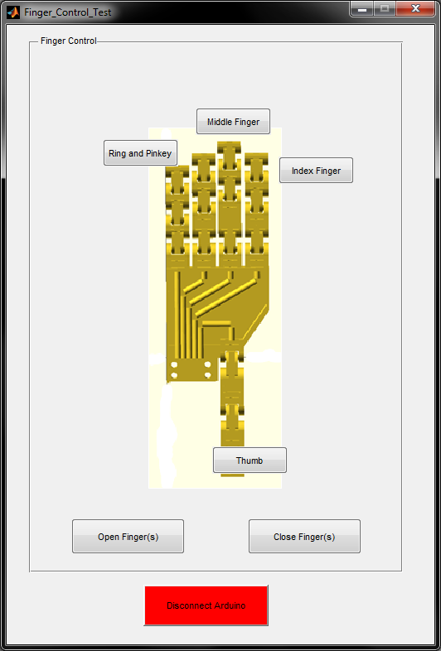
Programming Updates - User Interface
GUIDE from MATLAB
Easy for the user
Toggle buttons to choose fingers
Buttons to close or open fingers

Slide 9
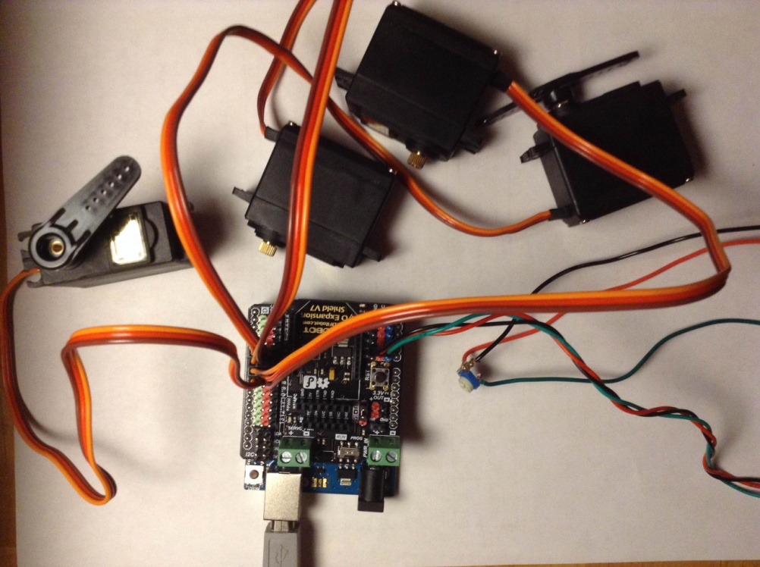
Programming Updates
Testing Setup
Connecting to PC via USB
Servos operating properly
Testing potentiometer

Slide 10
Programming Updates - Upcoming
What’s to come:
Ability to stop motors with potentiometers
Control of pump
Control of valve
Update GUI with options for pump and valve
Connect to Arduino Uno via Bluetooth

Slide 11
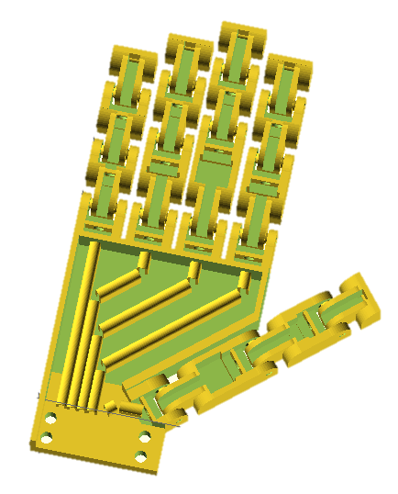
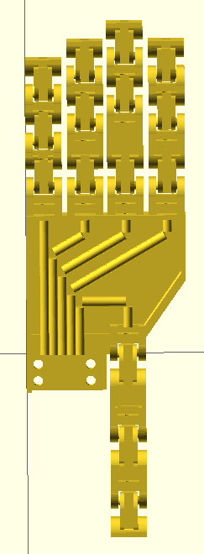
Palm Updates
As per Phase 4 design goals, a new version of the hand was made with repositioned thumb and redesigned cable guides
The new design also featured a slightly higher tolerance to eliminate bridging
This design was printed on March 4th
Some parts worked as expected and some posed new design problems
Old (top) and new (bottom) hand designs.

Slide 12
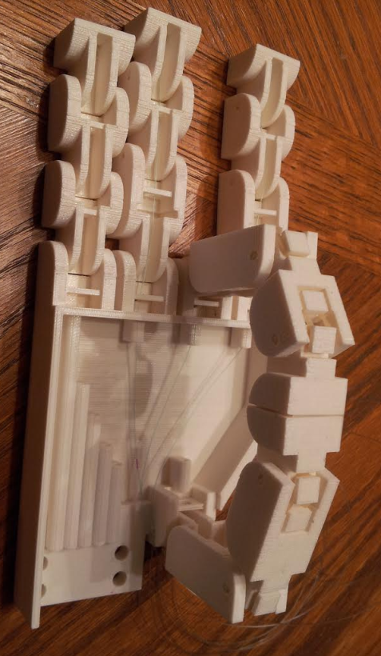
Palm Updates
The thumb was moved to a position where it would meet with the middle finger upon tightening the cable
This allows the hand to pick up small objects
The design differs slightly from the human hand
The human hand typically uses the index finger to manipulate small objects
However, putting the thumb at an angle meeting the index finger interferes with the forearm mount
This difference should not interfere with day-to-day tasks
This aspect of the design worked as expected and displayed correct finger motion
Hand demonstrating desired motion.

Slide 13
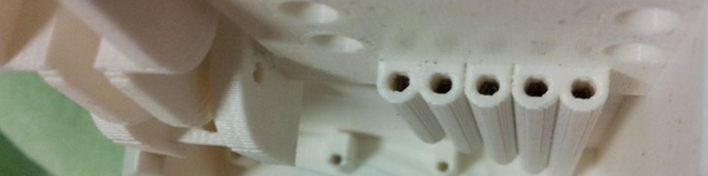
Palm Updates
The redesigned cable guides, however, did not work
This is because the hole for the cable had too small of a surface area for support material removal
Support material is typically removed via an acid bath
The cross section of the cable guide holes was too small for the acid bath to access the support material
Therefore the cable guides are clogged and the cable guide design must be revisited
Solution: Add more surface area to cable guide holes
Cable guide holes are blocked with black support material

Slide 14
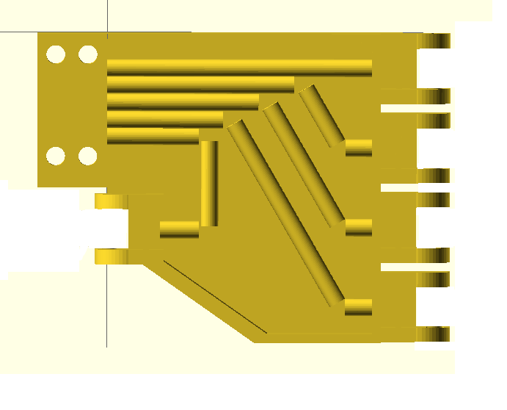
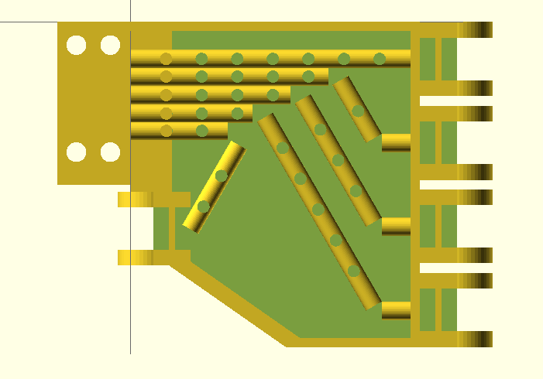
Palm Updates
Current palm design:
Holes have been added to allow acid to access support material
Cable guides have again been made into a U shape, creating more surface area in the tunnel itself
Thumb cable guide has been reconfigured into an “A” shape to create better leverage
Old (left) and new (right) palm designs

Slide 15
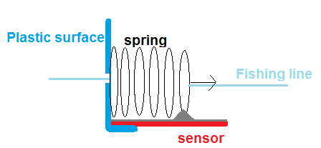
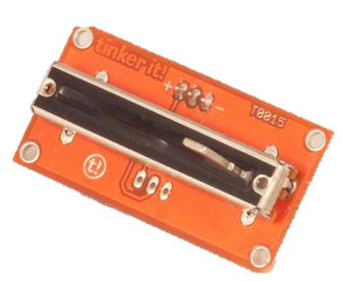
Sensor Updates
Phase 4 sensor setup required motor slides
This required a moving part in the forearm, adding complexity to the design
Forearm design was already proving to be very complex and posed a problem keeping with project timelines
New sensor setup proposed: Springs and linear potentiometers
These negate the need for motor slides
They work on the same principle as the motor slides

Slide 16
Sensor Updates
How the new sensor setup works:
It takes a nominal force to reel in the finger
When the finger makes contact, the force spikes
A spring connecting two sections of cable stretches more under greater force
Therefore, contact can be determined via spikes in spring position
This can be also used to determine exact force at the finger
If the K value of the spring is known, force can be interpolated using Hooke’s law
However, force calculation will not be within the scope of this project
Requires conversion of logarithmic scale of the potentiometers to a linear change in distance

Slide 17
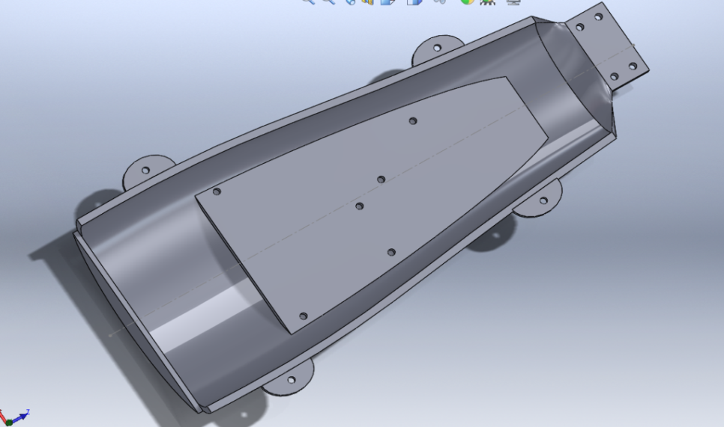
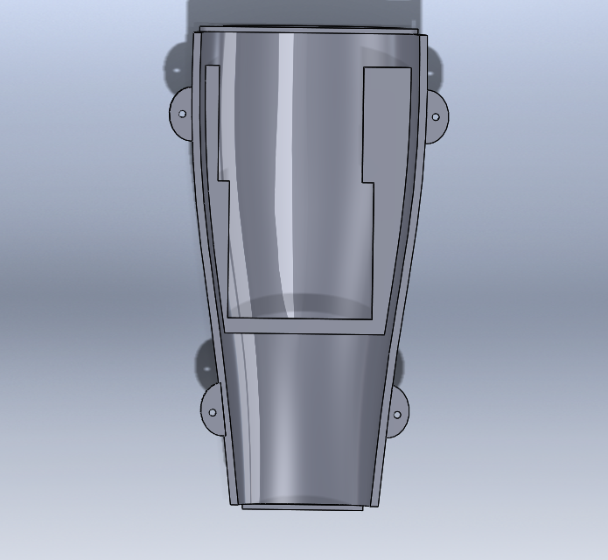
Forearm Design
Originally planned to reuse InMoov forearm
This proved difficult since the InMoov could not be imported into SolidWorks
Solution:
Model forearm from scratch
Top case
Hand mounting
Arduino and shield mounting
Bottom Case
Servo motor mounting

Slide 18
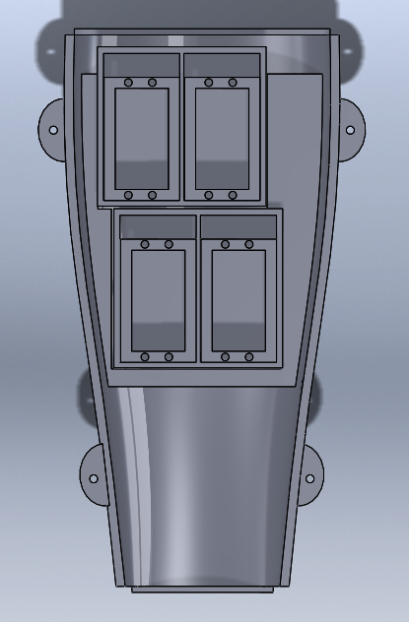
Forearm Design – Moving Forward
Mounts must still be made for the following components:
Pump
Pneumatic valve
Battery
Sensors
It is possible that not everything will fit inside the forearm
This is okay because this is a first prototype, proving that the concept works
Future users may hone the design so that everything does fit

Slide 19
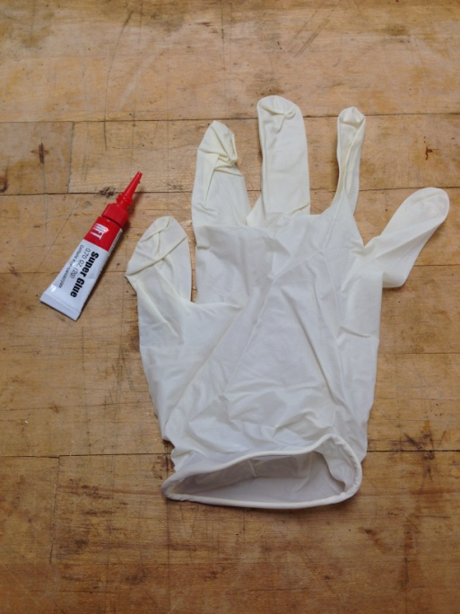
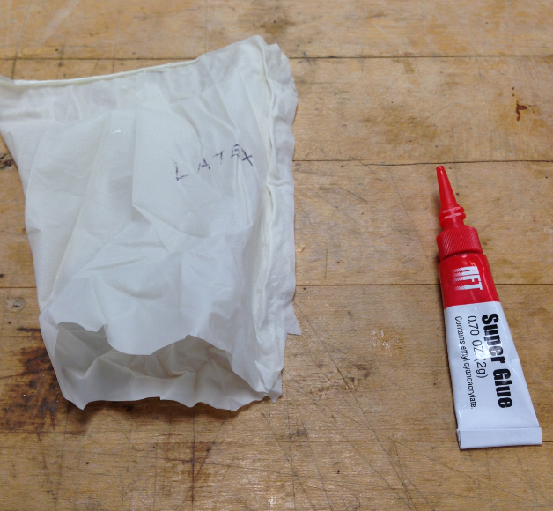
Granular Jamming
Original Idea: Slip cast latex in a 3D printed mold
Current Idea: Use a glove as the casing
Cut the fingers and cuff off, use the palm portion
Use super glue to seal the edges
Attempted using disposable latex, PVC, and nitrile gloves

Slide 20
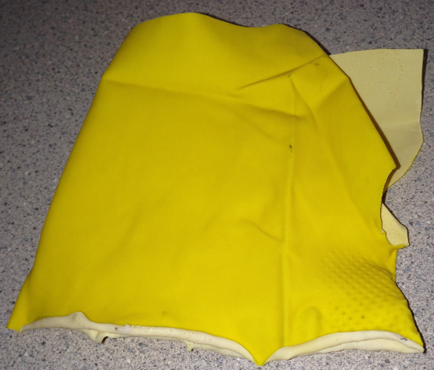
Granular Jamming
Disposable gloves showed promise to be airtight and were easy to construct. However there was concern about the durability of the gloves.
Solution: Reusable kitchen gloves
Problems Encountered:
The first set (yellow) were crumpled from being in the package, preventing them from forming an airtight seal.
Since reusable gloves have a dedicated left and right glove, it was much harder to cut a large area to use

Slide 21
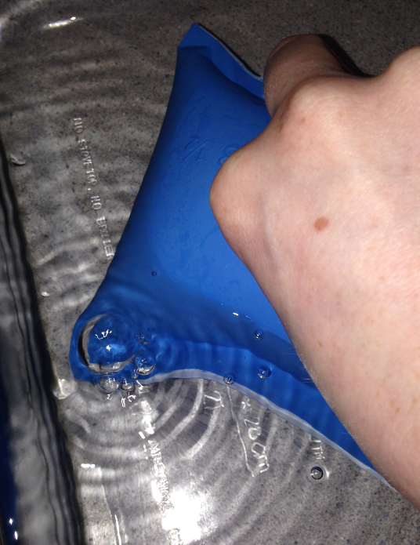
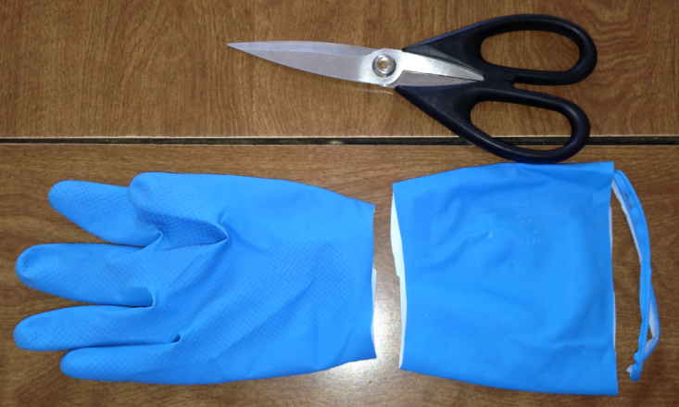
Granular Jamming
Tried different gloves with a longer cuff and a cotton flock lining
Used the cuff instead of the palm of the glove
Able to secure the edges with glue (leaving a 1” opening)
Inflated the glove and submerged it in water to look for leaks
Bubbles indicated an air leak, so the glove was removed and the leak was fixed with more superglue, which made a successful airtight pocket.

Slide 22
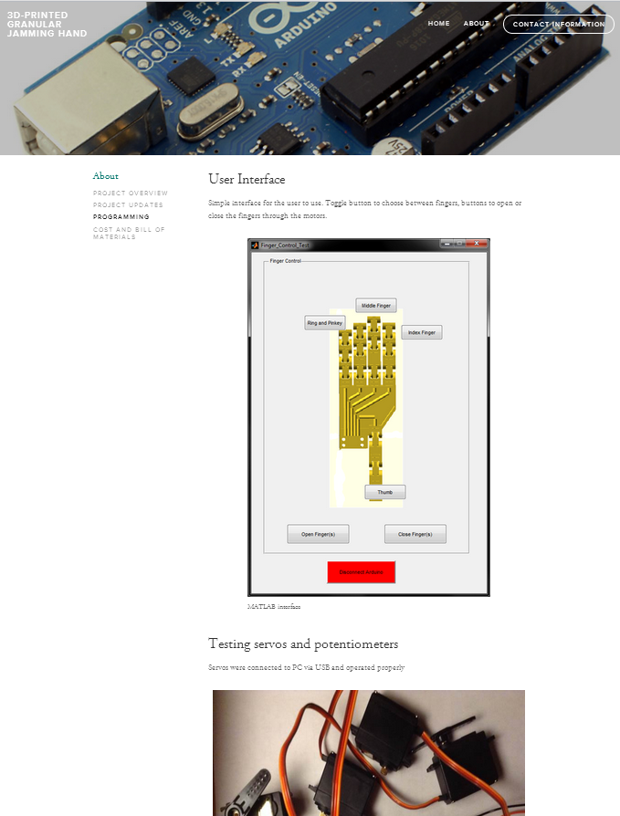
Website Updates
The website has been updated
Design changes:
Totally new format
New navigation
Content changes:
Updated with all of the latest project work
Web address:
http://granular3dhand.squarespace.com/

Slide 23
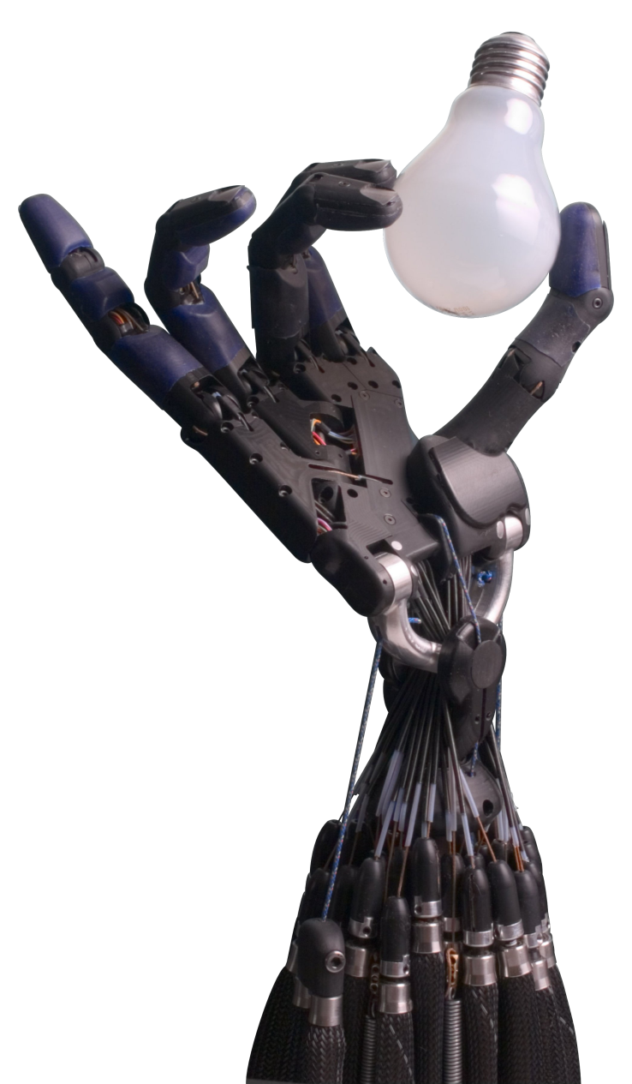
Moving Forward
Hardware
Finish forearm design
Print hand and forearm
Assemble hand and forearm
Integrate granular jamming
Assembly of electronics inside housing
Software
Finish programming
Integration of potentiometers
Control of pump and valve
Continue updating website

Slide 24
Bill of Materials
Quantity | Part Purchased | Price
1 | Arduino Uno board REV3 | $28.57
1 | I/O expansion shield | $15.99
2 | Relay module V2 | $15.60
4 | MG995 metal servo | $9.52
1 | 12V expandable battery | $25.99
1 | 3/8" x 3/4" springs | $8.90
1 | Microbrushless air vacuum pump | $82.50
1 | Solenoid pneumatic valve | $49.95
1 | Arduino bluetooth dongle | $6.78
1 | Pneumatic tubing | $10.50
4 | Linear potentiometer | $43.61
 | Total Price: | $297.91

Slide 25
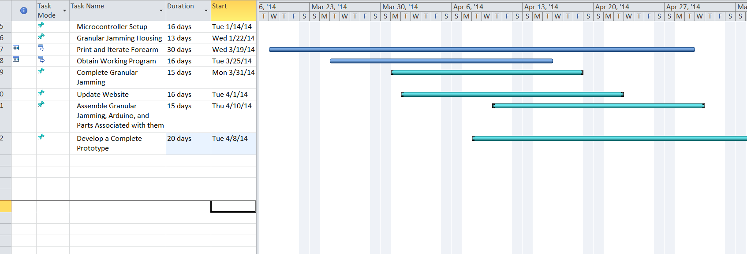
Gantt Chart

Slide 26
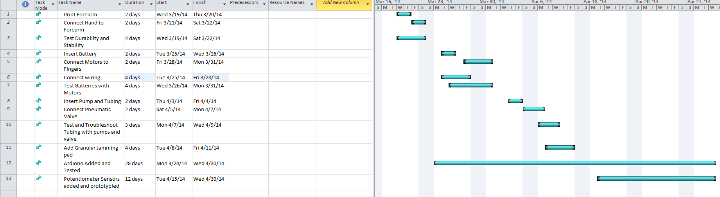
Construction/Testing Time Table

